Slide 1


GOLD PRICE PREDICTION
MENTOR
Mr. Rajshekhar
Ms. Pallavi
TEAM MEMBERS FROM (GROUP – 3)
Ms. Ahire Mrunal Arun
Ms. Jejurkar Payal Raosaheb
Ms. Sawant Prachi Rajesh
Mr. Kakaraparthi Mahesh
Mr. Jaybhaye Rushikesh Dinkarrao
Mr. Kanala Suman Kumar

Slide 2
Business Objective
Data provided is related to gold prices. The objective is to understand the underlying structure in your dataset and come up with a suitable forecasting model which can effectively forecast gold prices for next 30 days.
This forecast model will be used by gold exporting and gold importing companies to understand the metal price movements and accordingly set their revenue expectations

Slide 3
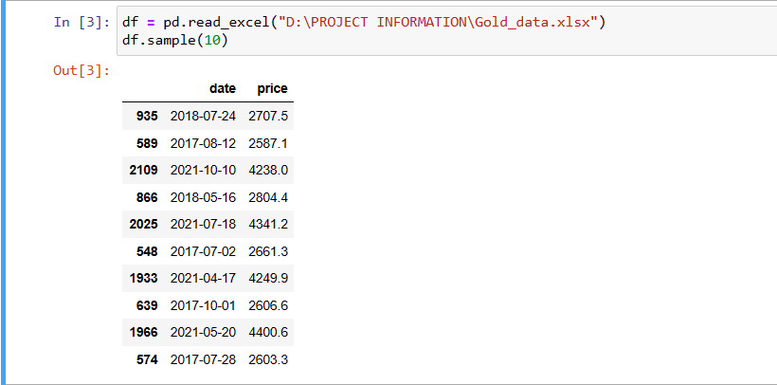
DATA SET DETAILS
This dataset contains information about Gold Prices from 2016 to 2021

Slide 4
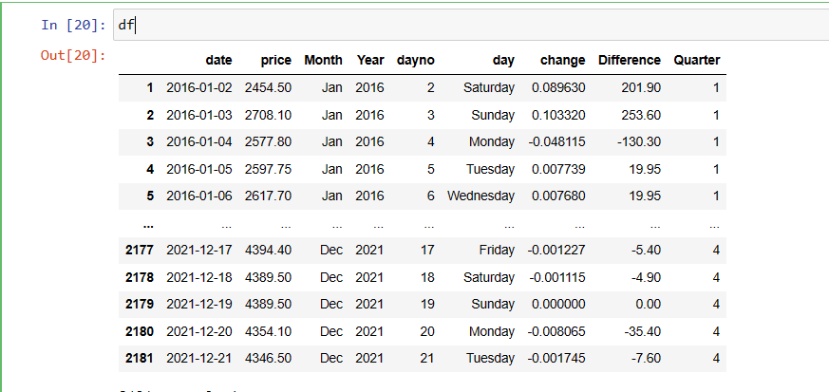
Changes ARE DONE BY adding days , MONTHS, differences and Quarter for data preprocessing
Data Preprocessing

Slide 5
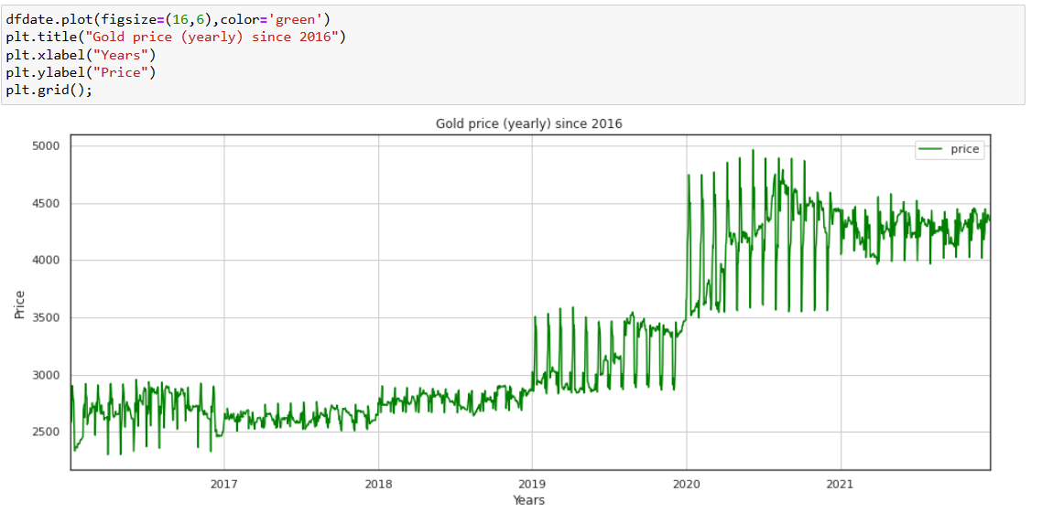
DATA SET Visualization In Line graph

Slide 6
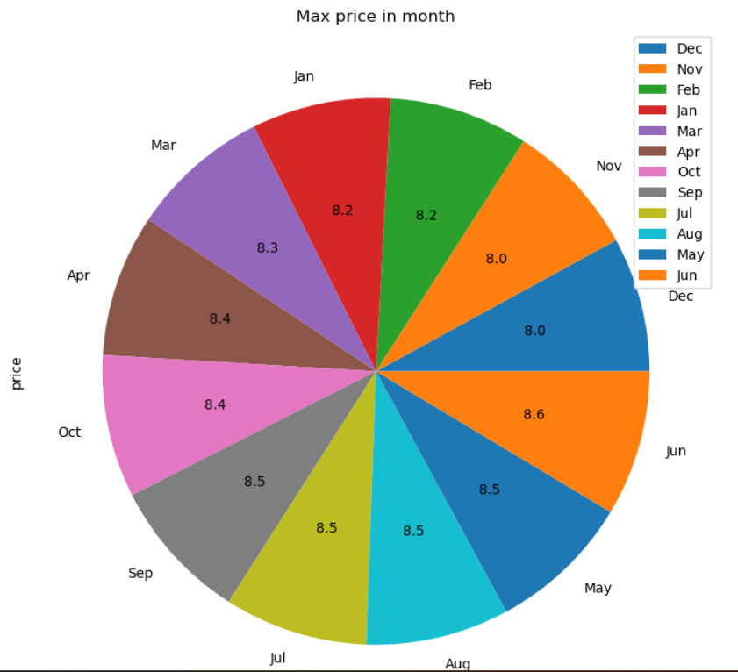
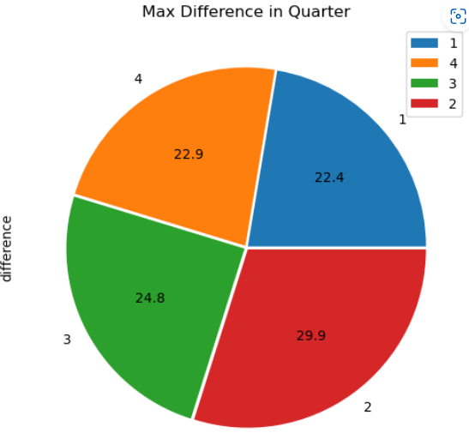
EXPLORATORY DATA ANALYSIS
PRICE DISTRIBUTION BY MONTHLY PRICE DISTRIBUTION BY QUARTERS

Slide 7
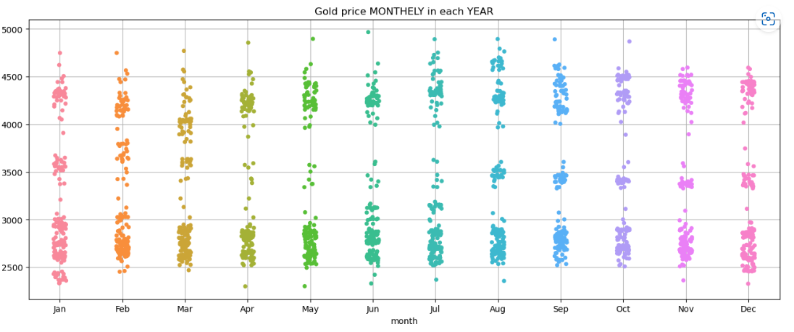
STRIP PLOTS
Gold price yearly in each month

Slide 8
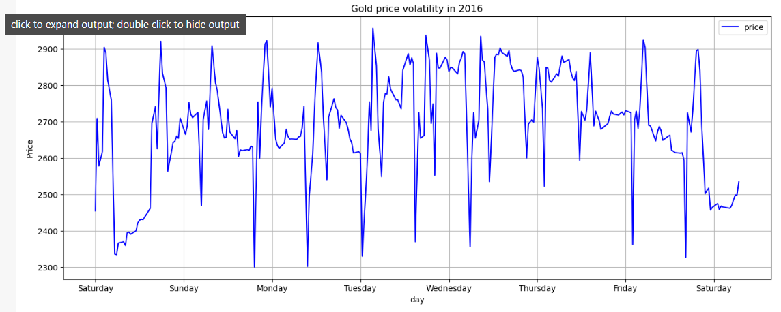
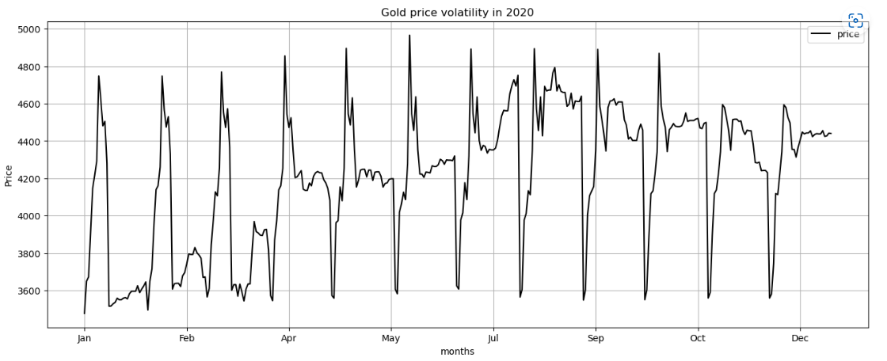
Volatility PLOTS
Gold price volatility in 2016 IN days
Gold price volatility in 2020 in months

Slide 9
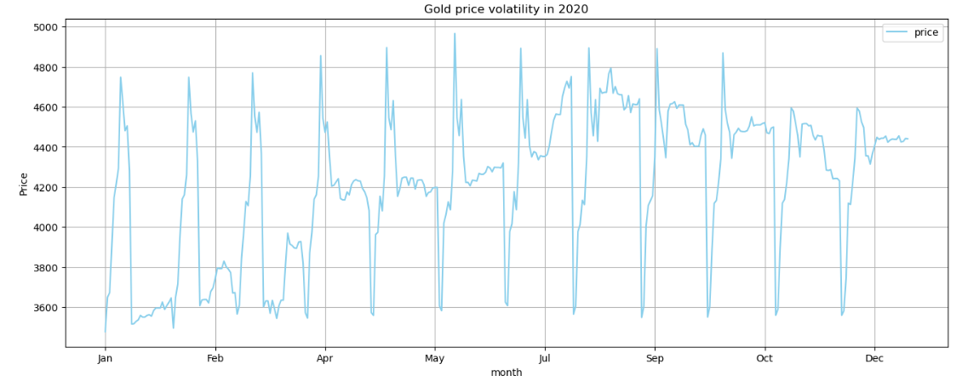
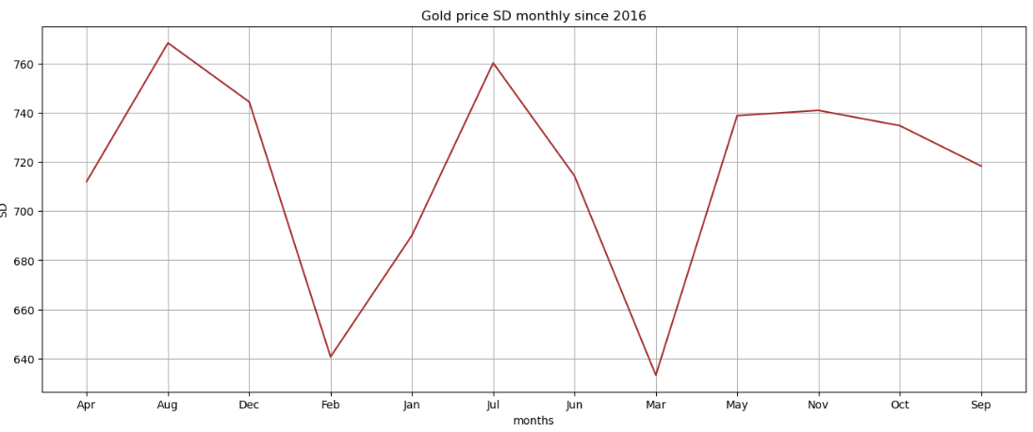
Gold price volatility in 2020 in MONTHS
Gold price SD monthly since 2016

Slide 10
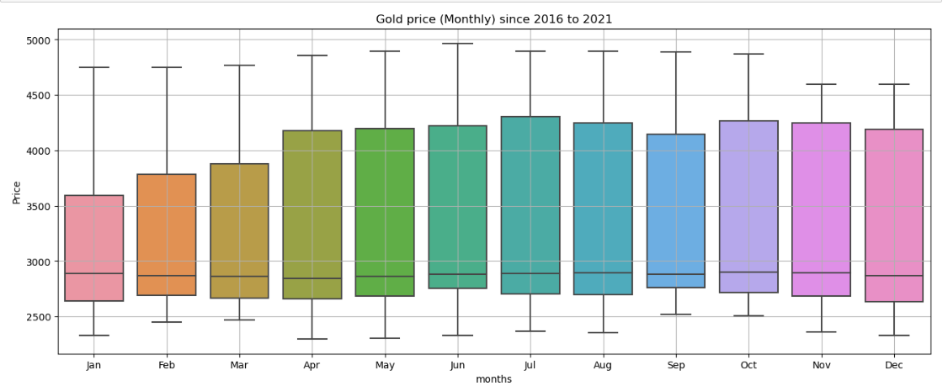
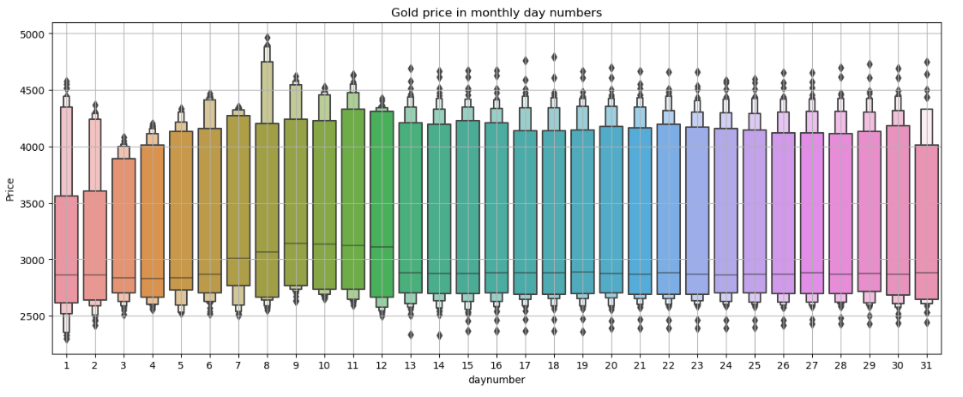
BOX PLOTS

Slide 11
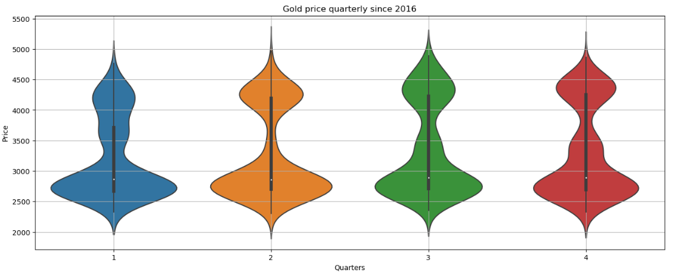
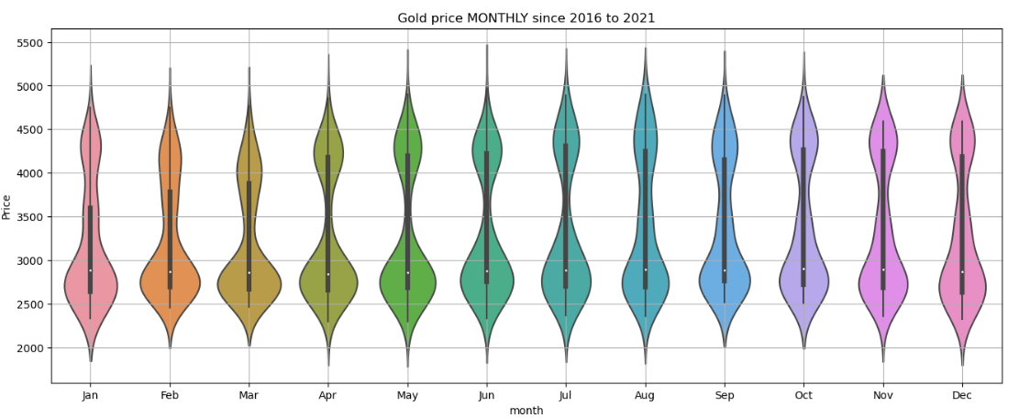
VIOLIN PLOT

Slide 12
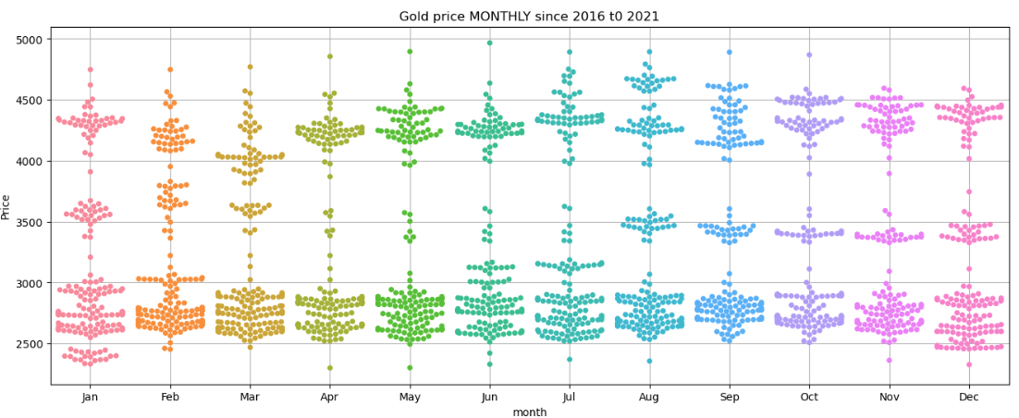
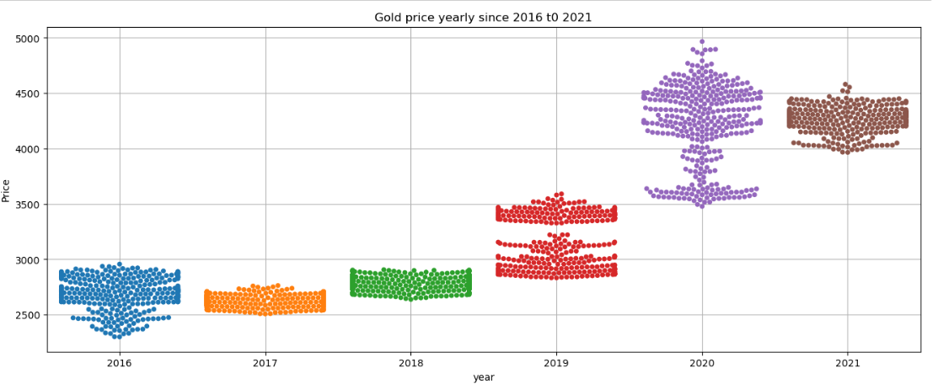
SWARM PLOT

Slide 13
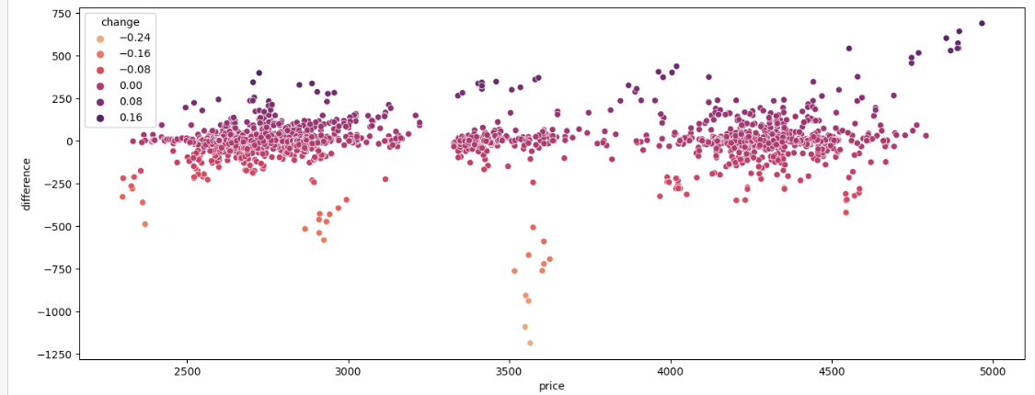
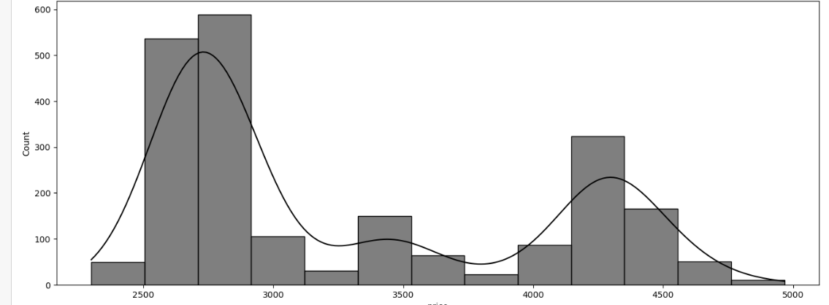
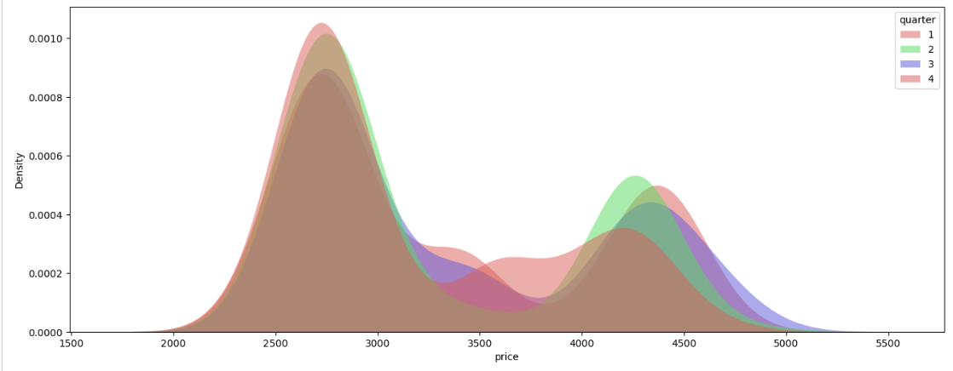
SCATTER PLOT ,HISTOGRAM

Slide 14
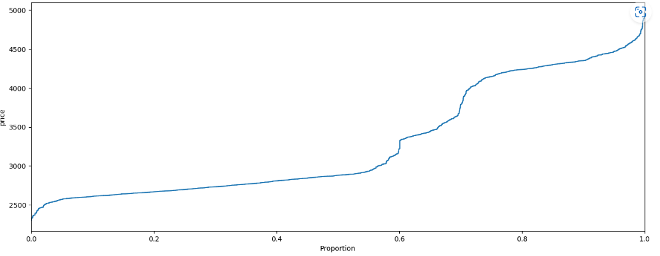
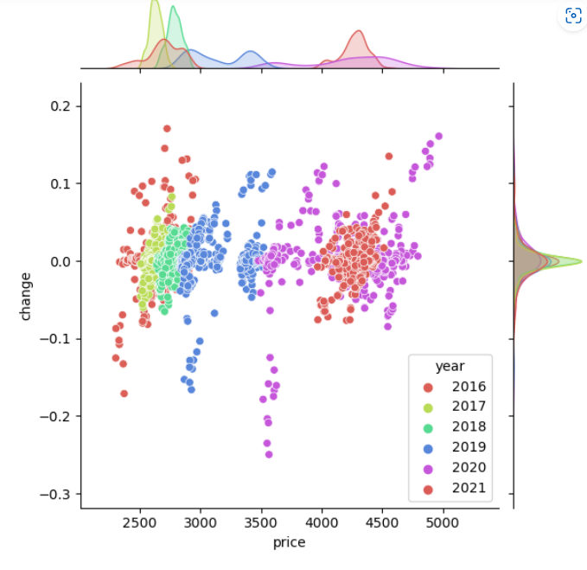
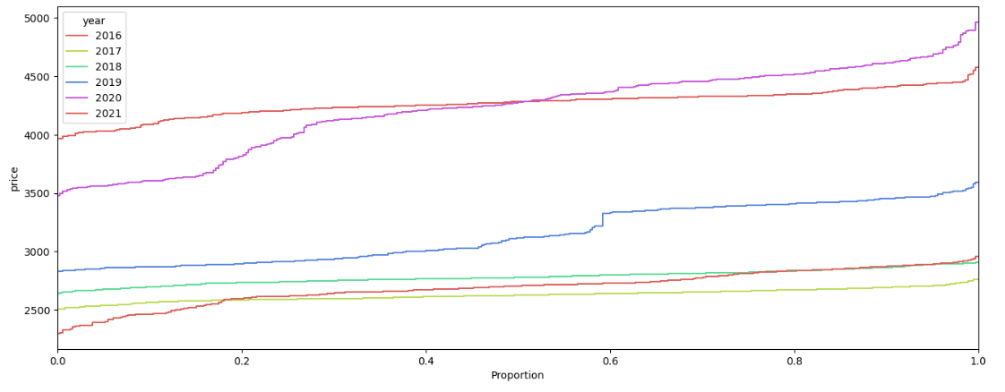

Slide 15
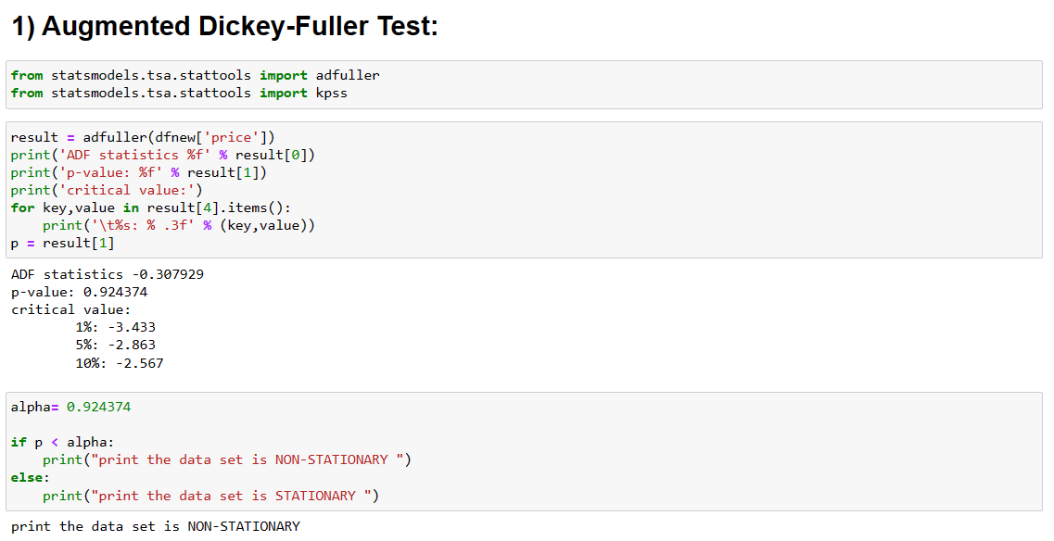
Cheking Data Is Stationary or Non-Stationary

Slide 16
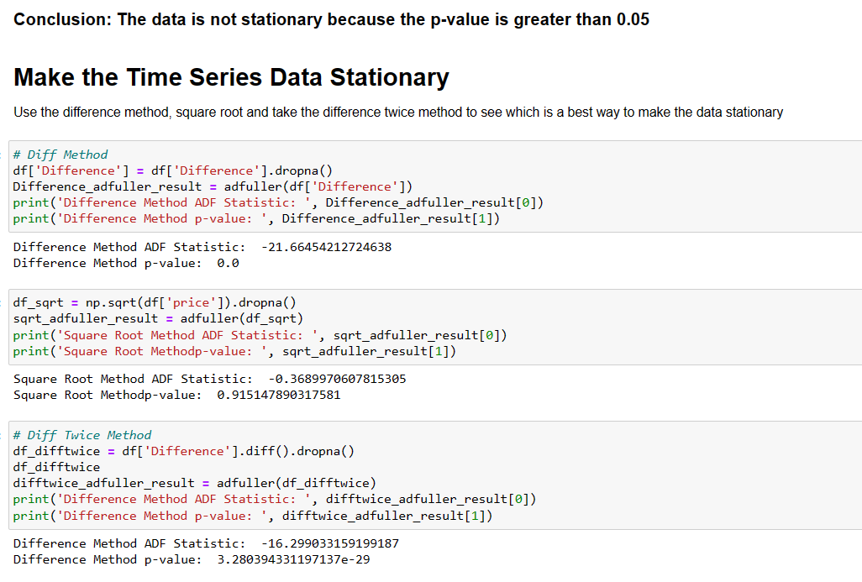
Make the Time Series Data Stationary

Slide 17
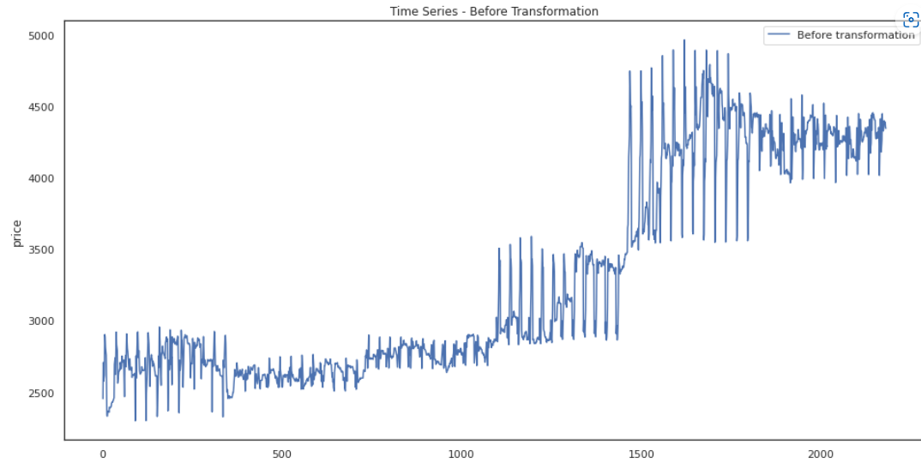
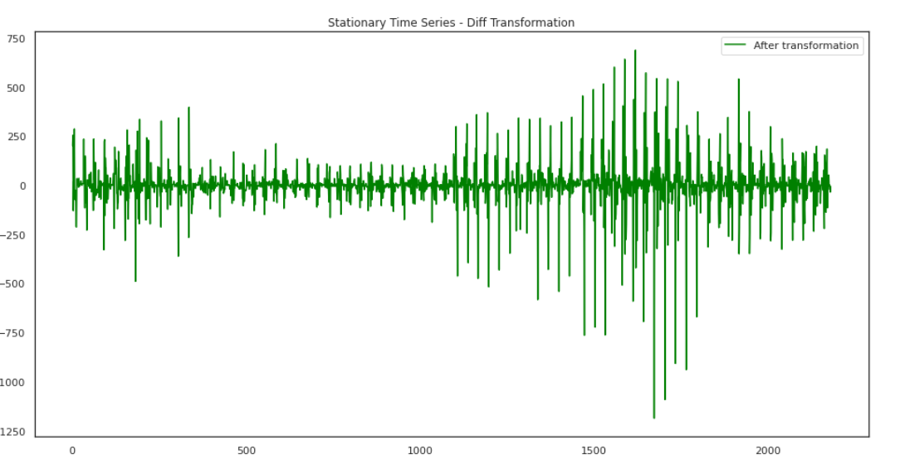

Slide 18
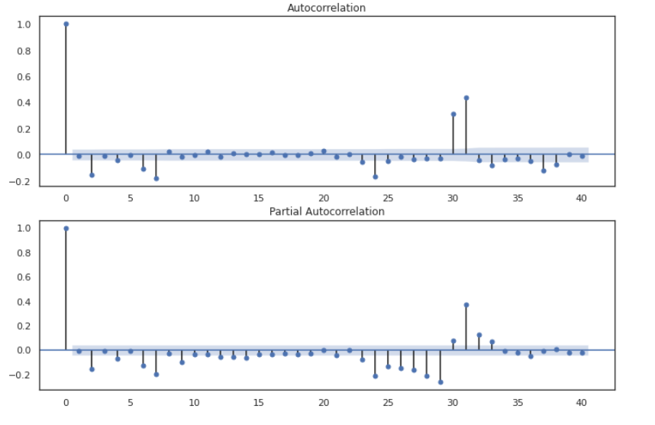
ARIMA MODEL

Slide 19
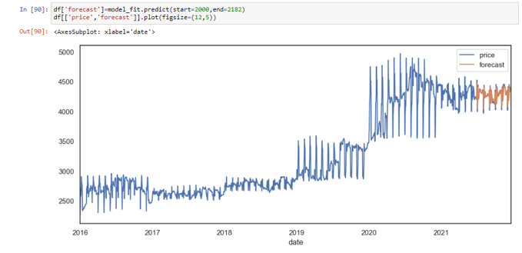
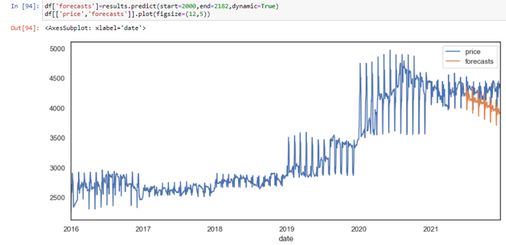
ARIMA & SARIMAX FORECAST

Slide 20
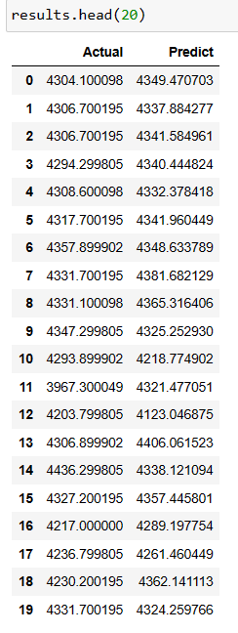
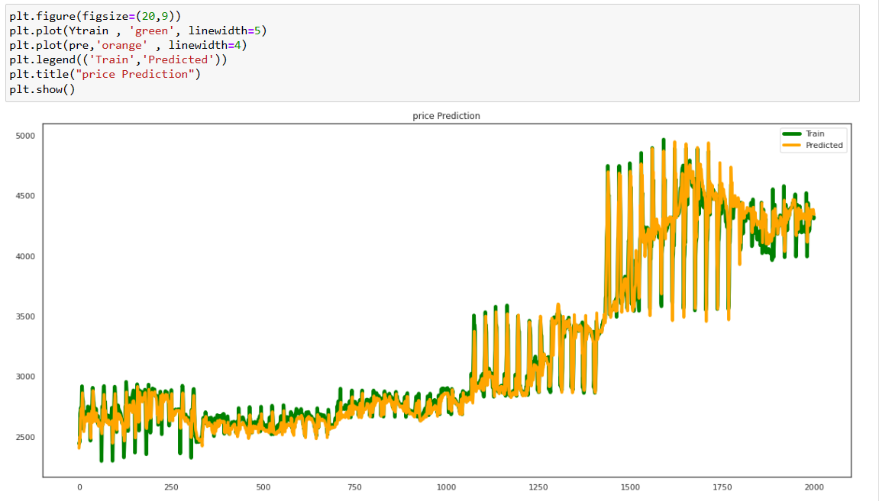
LSTM MODEL
LSTM line plot and data like same to original

Slide 21
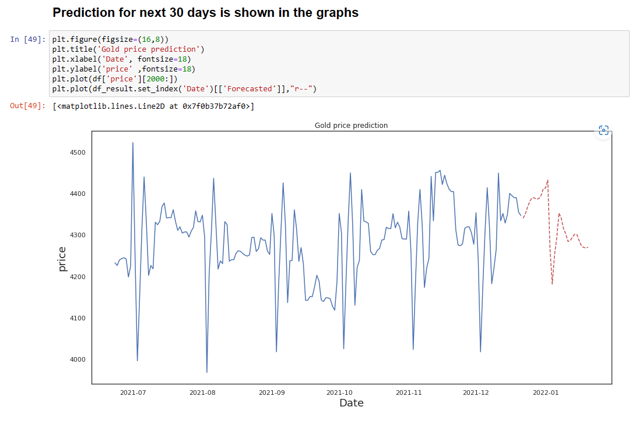
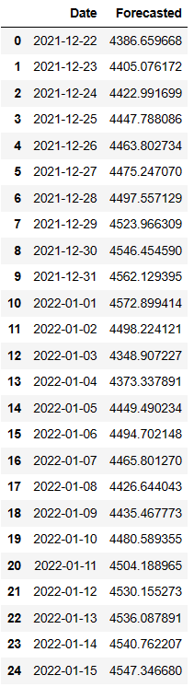
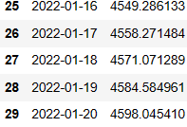
The RMSE value for LSTM model is 76.09
Finally selected LSTM model for forecasting.

Slide 22
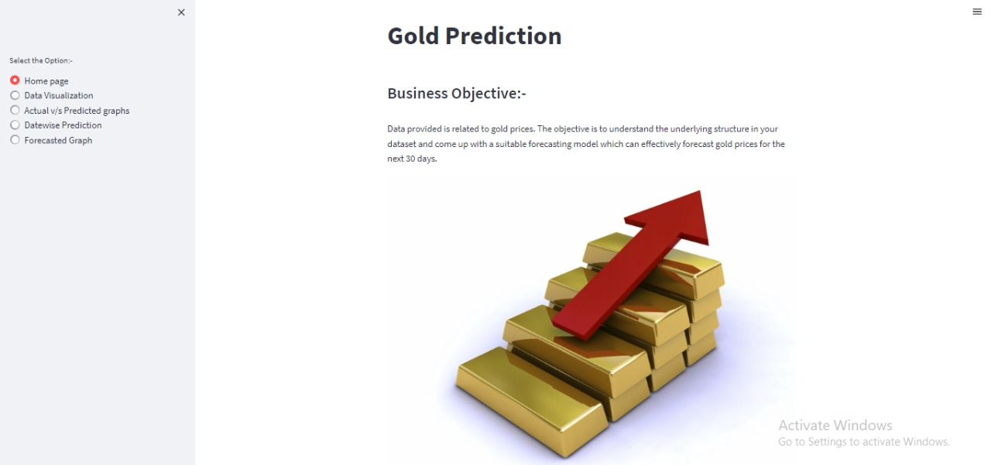
Home page deployment
Business Objective

Slide 23
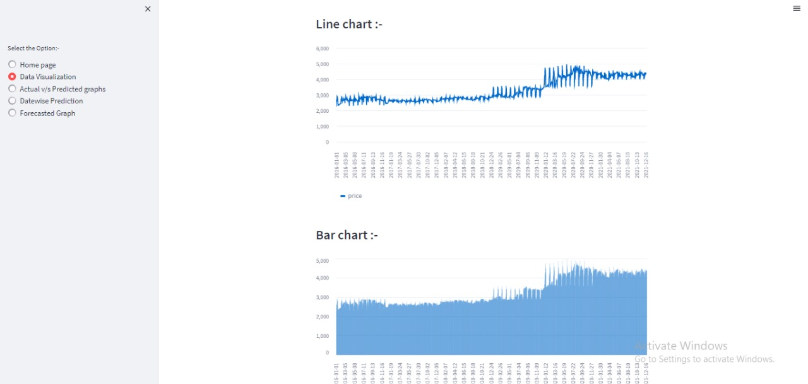
Data visuvalization in deployment

Slide 24
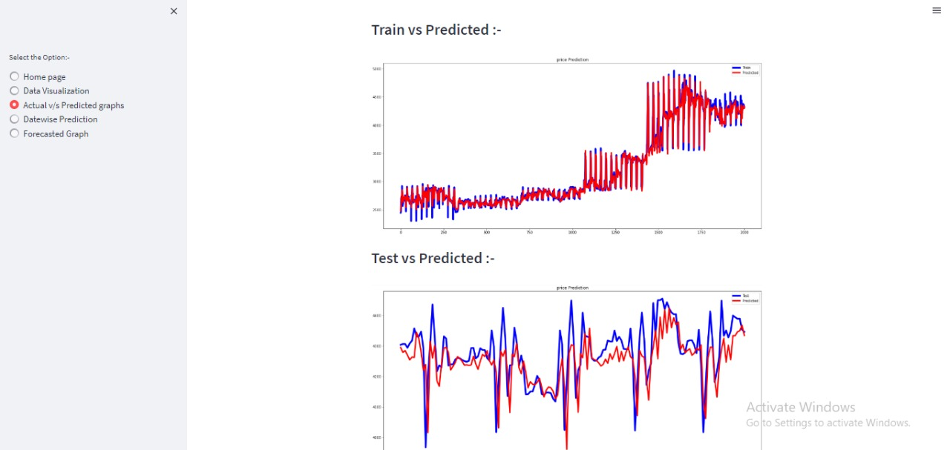
GRAPHS ACTUAL vs PREDICTION

Slide 25
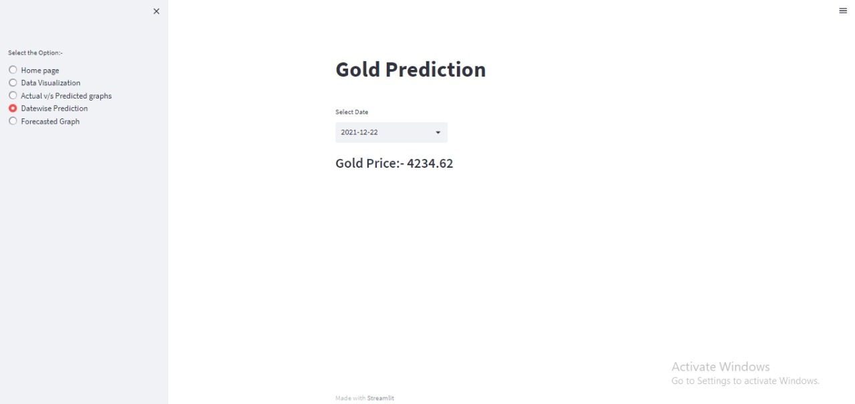
Forecasted value for date

Slide 26
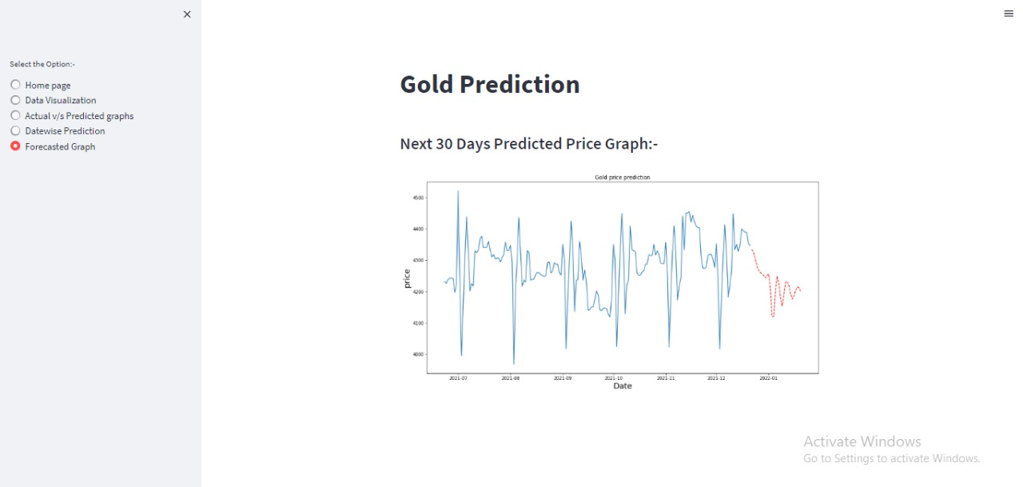
Forecasted graph

Slide 27
FOR ANY QUERIES
Ms. Mrunal Arun Ahire mrunalahire2022@gmail.com
Ms. Payal Raosaheb Jejurkar payaljejurkar@gmail.com
Ms. Prachi Rajesh Sawant prachisawant099@gmail.com
Mr. Kakaraparthi Mahesh kakaraparthimahesh98.gmail.com
Mr. Jaybhaye Rushikesh Dinkarrao rushikesh.jaybhaye@gmail.com
Mr. Kanala Suman Kumar sumankanala13@gmail.com

Slide 28
THANK YOU

